Slide 1

Capstone Project
Play Store App Review Analysis
By
Manjeet Srivastava
Vivek Kumar
Rishabh Srivastav
Shubham Bharti
Durga Shankar
Data Science Trainee, AlmaBetter

Slide 2






WHY ANALYZE THE GOOGLE PLAY STORE?
Mobile App Market is set to grow 20% by 2023
Android Apps comprise 90% of the Mobile App Market
What makes an App popular? Can we predict how popular it’s going to be?
What are some interesting patterns in user behavior related to app usage & feedback?

Slide 3

Introduction
Android is the most popular operating system in the world, with over 2.5 billion active users spanning over 190 countries.
Google Play was launched on March 6, 2012, bringing together Android Market marking a shift in Google's digital distribution strategy .
Android is the dominant mobile operating system today more than 85% of all mobile devices running Google’s OS. The Google Play Store is the largest and most popular Android app store.
There are more than 3.04 million apps found on Google Play Store.
The Play Store apps data has enormous potential to drive app-making businesses to success.
Actionable insights can be drawn for developers to work on and capture the Android market. The main goal of our project is-
The purpose of our project is to gather and analyze detailed information on apps in the Google Play Store in order to provide insights on app features and the current state of the Android app market.
The Objective of the project to Explore and analyze the data to discover key factors responsible for app engagement and success.

Slide 4


Problem Statement
Problem Statement
Two datasets are provided, one with basic information and the other with user reviews for the respective app.
We must examine and evaluate the data in both datasets in order to identify the important characteristics that inﬂuence app engagement and success.
So, what factors inﬂuence an app's success?
An app is said to be successful if it has:
A high average user rating
A good number of positive reviews
A good number of monthly average users
High revenue per customer and so on.

Slide 5

Agenda
NUMBER OF APPS IN EACH CATEGORY
MOST OF THE FALLS UNDER WHICH GENRE
NUMBER OF FREE AND PAID APPS IN EACH CATEGORY
PERCENTAGE OF FREE AND PAID APPS
NUMBER OF APPS INSTALLS IN EACH CATEGORY
DISTRIBUTION OF PAID APPS
Distribution of FREE APP
TOP 10 INSTALLED APP IN SPORTS CATEGORY
TOP 10 PAID APPS
AVERAGE PRICE OF PAID APPS IN EACH CATEGORY
TOTAL PRICE IN EACH CATEGORY(SUM)
WHAT IS THE FREE AND PAID APPS SIZE (IN MB)
DATA SHAPE
DISTRIBUTION OF RATING

Slide 6



POINT PLOT OF AVERAGE RATING IN EACH CATEGORY
COUNTPLOT OF RATING(TOP10)
PLOT THE BARGRAPH FOR CONTENT RATING
BARPLOT DISPLAYING THE RATING FOR EACH CONTENT RATING
PLOTTING THE OVERALL SENTIMENT OF REVIEWS
TOP APPS HAVING HIGHER NUMBER OF REVIEWS
PLOTTING OF POSITIVE REVIEWS
WORD CLOUD FOR POSITIVE REVIEWS
PLOTTING OF NEGATIVE REVIEWS
WORD CLOUD OF NEGATIVE REVIEWS
CORELATION BETWEEN RATING,REVIEWS,SIZE AND INSTALLS

Slide 7
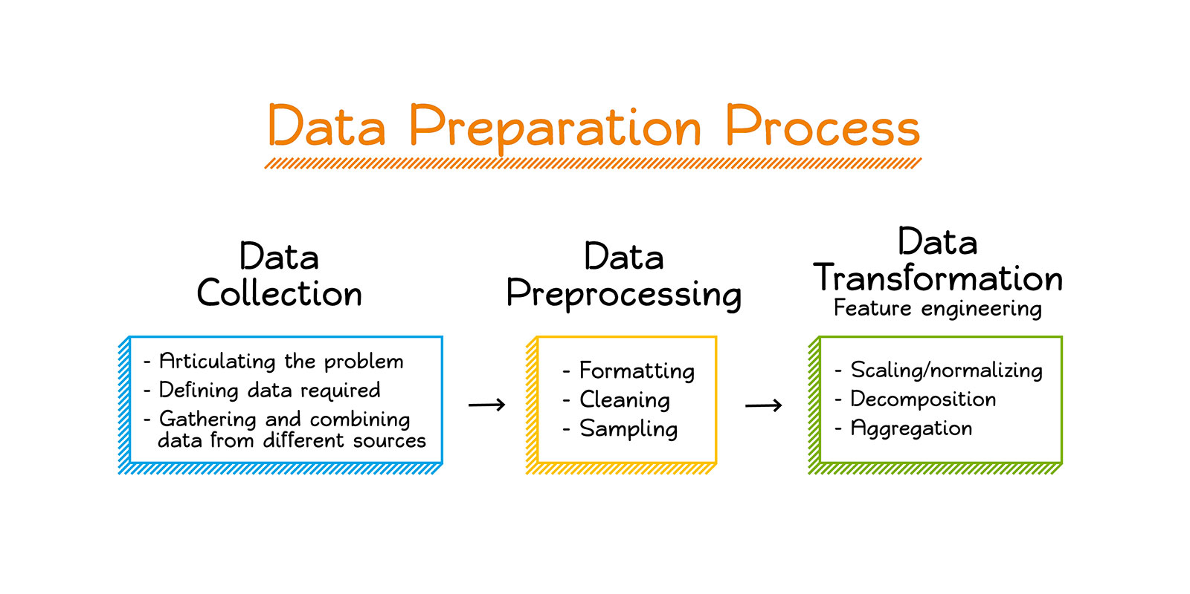
Dataset Preparation
Loading the data sets :Two datasets, First Play store app
dataset and User Reviews dataset.
Import Libraries: NumPy, Pandas, Seaborn and Matplotlib
Data cleaning: Null values, Finding and removing Outliers, Removing duplicate data.
Data Imputation: Filling the missing categorical values with mode and numerical values with median. Conversion of price, installs, reviews into numerical values.
Exploratory Data Analysis: Analyzing the data sets to summarize their main characteristics using statistical graphics and data visualizations method.

Slide 8
1.App : This column Contains the name of the app for each observation. 2.Category : This column Contains Category to which the app belongs. 3.Rating : This column contains the average rating for the app. 4.Reviews : This column contains the number of reviews that the app has received on the play store. 5.Size : This column contains the amount of memory the app occupies on the device. 6.Installs : This column contains the number of times that the app has been downloaded and installed from the play store. 7.Type : This column contains the information whether the app is free or paid. 8.Price: If the app is a paid app, this column contains the data about its price. 9.Content Rating: This column contains the maturity rating of the app i.e. the age group of the audience for which it is suitable. 10.Genres: This column contains the data about to which genre the app belongs. Genres can be considered as a further division of the group of Category. 11.Last Updated: Contains the date on which the latest update of the app was released. 12.Current Version: Contains information on the current version of the app available on the play store. 13.Android Version: Contains information about the android versions on which the app is supported.
Attributes in Google Play store Data

Slide 9

Attributes in User reviews
App- Application name
Translated Review- User review
Sentiment- Positive/Negative/Neutral Reviews
Sentiment Polarity- Sentiment polarity score
Sentiment Subjectivity- Sentiment subjectivity score

Slide 10



OVERVIEW OF ANALYSIS
Data Cleaning
Data Exploration
Predictive Modeling
Understand the structure of the dataset and clean data before analysis
Uncover initial patterns, characteristics, and points of interest using visual exploration
Formulate a statistical model to forecast an outcome using relevant predictors

Slide 11
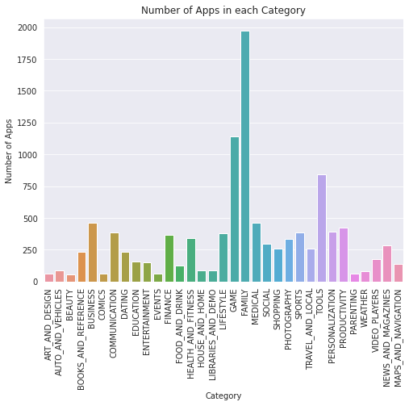
1. NUMBER OF APPS IN EACH CATEGORY

Slide 12
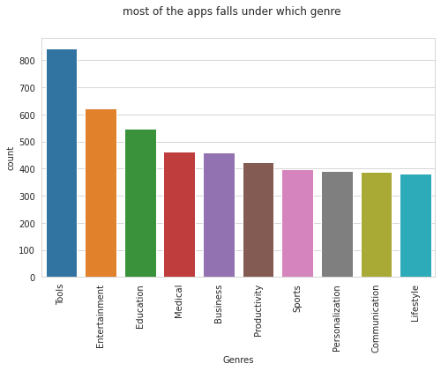
2. MOST OF THE FALLS UNDER WHICH GENRE

Slide 13
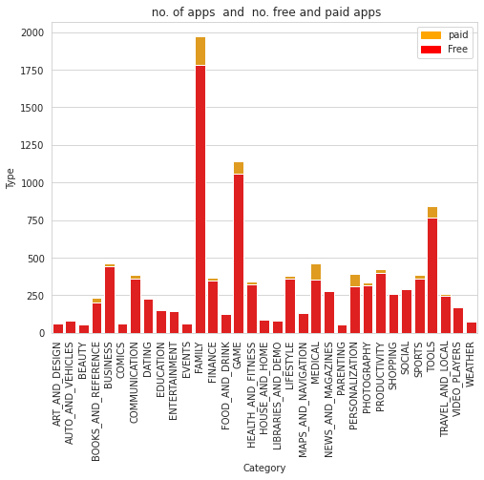
3. NUMBER OF FREE AND PAID APPS IN EACH CAEGORY

Slide 14
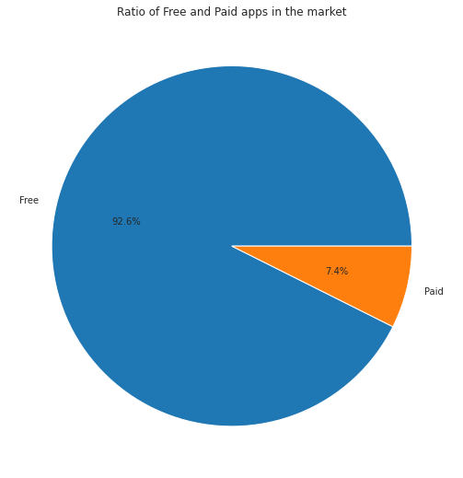
4. RATIO OF FREE AND PAID APPS

Slide 15
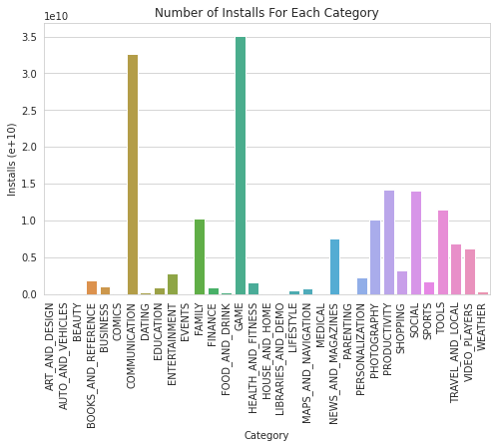
5. NUMBER OF APPS INSTALLS IN EACH CATEGORY

Slide 16
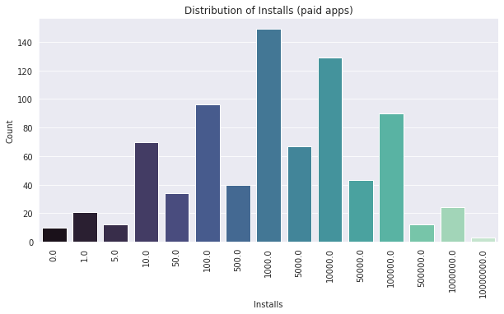
6. DISTRIBUTION OF PAID APPS

Slide 17
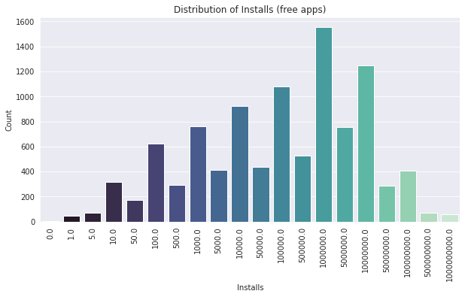
7.DISTRIBUTION OF FREE APPS

Slide 18
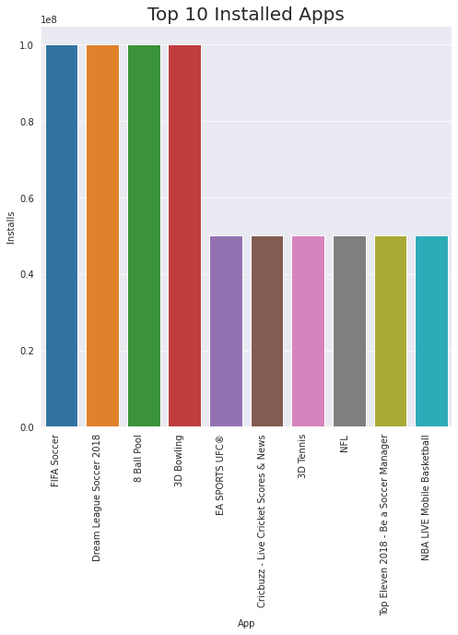
8. TOP 10 INSTALLED APP IN SPORTS CATEGORY

Slide 19
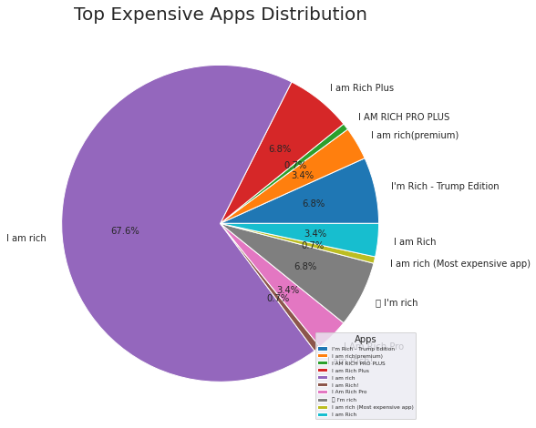
9. TOP 10 PAID APPS

Slide 20
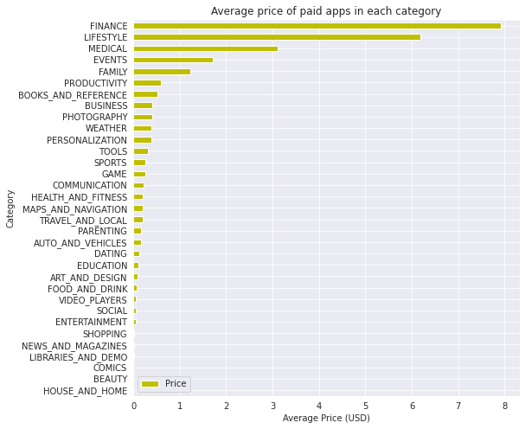
10. AVERAGE PRICE OF APPS IN EACH CATEGORY(IN USD)

Slide 21
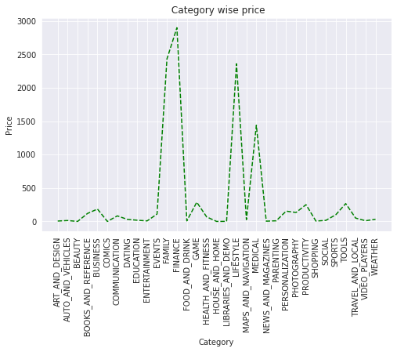
11. TOTAL PRICE IN EACH CATEGORY(SUM)

Slide 22
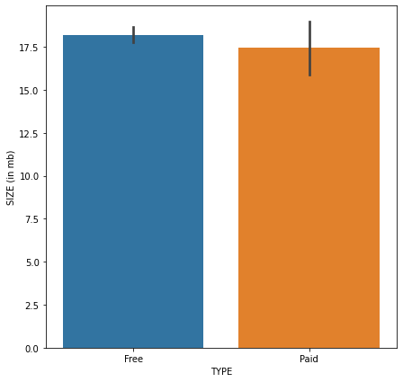
12. WHAT IS THE FREE AND PAID APPS SIZE (IN MB)

Slide 23
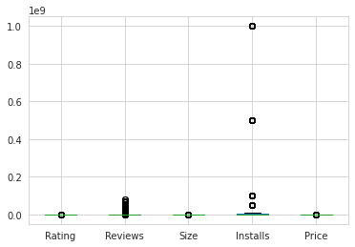
13. DATA SHAPE

Slide 24
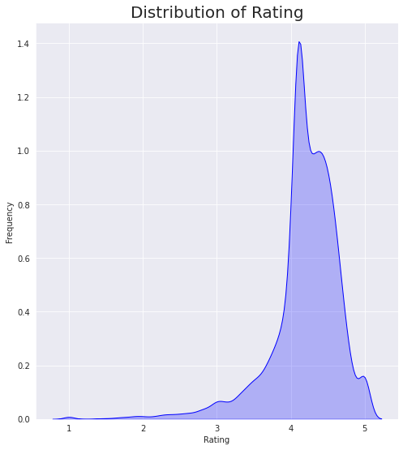
14. DISTRIBUTION OF RATING

Slide 25
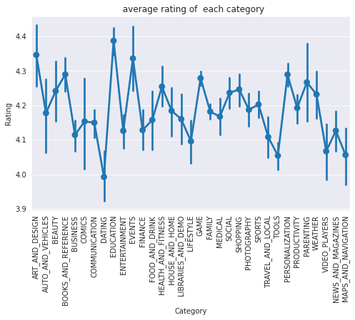
15. POINT PLOT OF AVERAGE RATING IN EACH CATEGORY

Slide 26
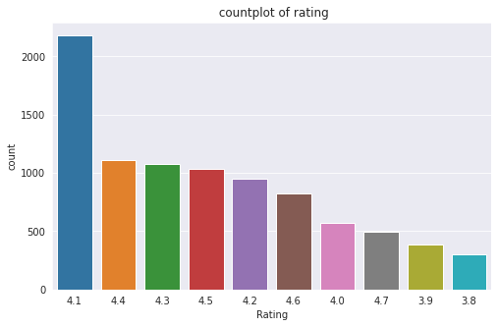
16. COUNTPLOT OF RATING(TOP10)

Slide 27
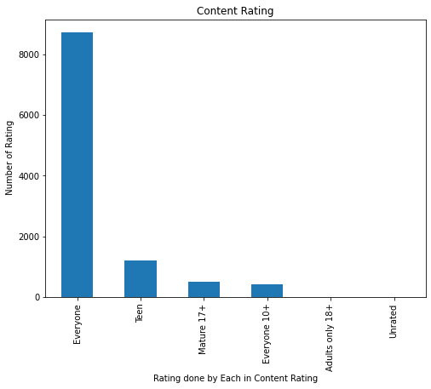
17. PLOT THE BARGRAPH FOR CONTENT RATING

Slide 28
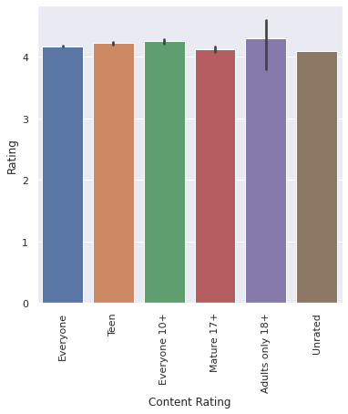
18.BARPLOT DISPLAYING THE RATING FOR EACH CONTENT RATING

Slide 29
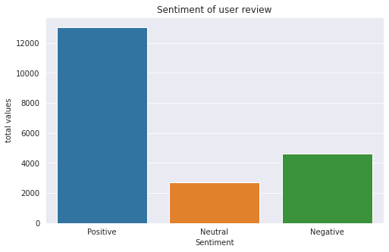
19. PLOTTING THE OVERALL SENTIMENT OF REVIEWS

Slide 30
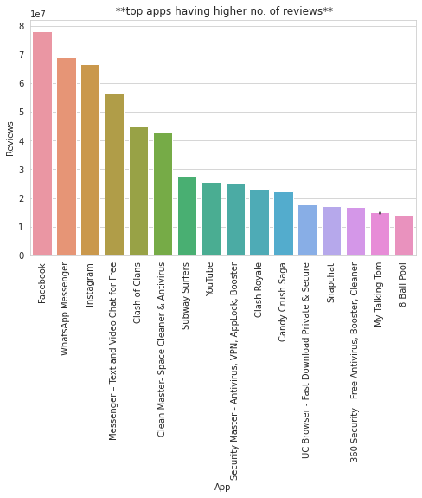
20. TOP APPS HAVING HIGHER NUMBER OF REVIEWS

Slide 31
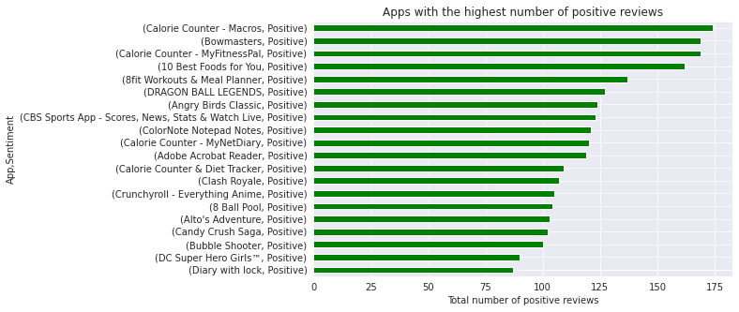
21. PLOTTING OF POSITIVE REVIEWS

Slide 32
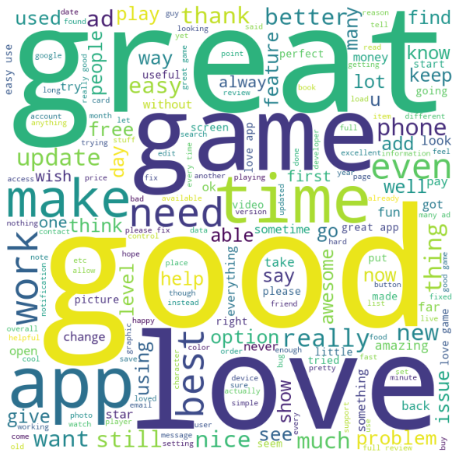
22. WORD CLOUD FOR POSITIVE REVIEWS

Slide 33
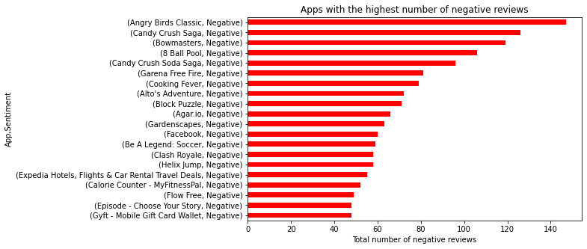
23. PLOTTING OF NEGATIVE REVIEWS

Slide 34
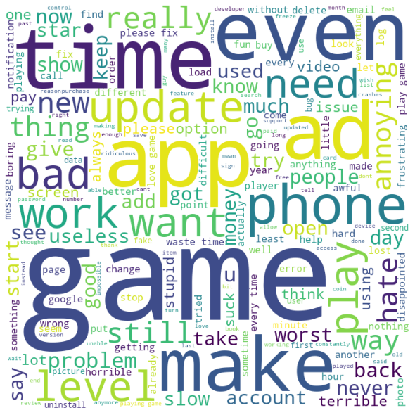
24. WORD CLOUD OF NEGATIVE REVIEWS

Slide 35
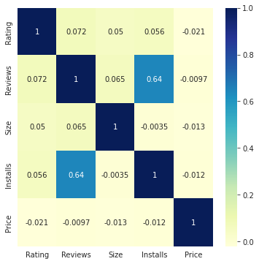
25. CORELATION BETWEEN RATING,REVIEWS,SIZE AND INSTALLS

Slide 36

Challenges Faced
Challenges Faced
Exploring the dataset and comprehending the problem statements.
Examining the business KPIs for app development and devising a solution to the problem.
Handling the error, duplicate and NaN values in the dataset.
Designing multiple visualizations to summarize the information in the dataset and successfully communicate the results and trends to the reader.

Slide 37
Conclusion
92.6% apps are Free and 7.4% apps are paid in type.
81.80% apps have Everyone content rating.
Events category has a highest mean rating of 4.39 and Dating category has lowest 4.05 rating.
Family, Game and Tools are top three categories having 1906, 926 and 829 app count.
Most competitive category: Family
Category with the highest number of installs: Game
Tools, Entertainment, Education, Business and Medical are top Genres.
8783 Apps are having size less than or equal to 50 MB.
7749 Apps has rating more than 4.0 including both type of app.
Overall sentiment count of merged dataset in which Positive sentiment count is 64%, Negative 22% and Neutral 14%.

Slide 38
Conclusion
It's good to develop a Free type app and having a content rating for Everyone.
Percentage of apps that are top rated = 81.80%
There are 20 free apps that have been installed over a billion times
Minecraft is the only app in the paid category with over 10M installs, and also has produced the most revenue only from installation fee.
Price, Rating, Size has no or very less correlation with Sentiment Polarity.
The median size of the apps in the play store is 12 MB
The apps whose size varies with device has the highest number average app installs.
The apps whose size is greater than 90 MB has the highest number of average user reviews, ie, they are more popular than the rest.
Helix Jump has the highest number of positive reviews and Angry Birds Classic has the highest number of negative reviews.

Slide 39


